Slide 1

Neuromorphic engineering: computational neuroengineering module
Mazzoni@Bionics 2025-2026

Slide 2
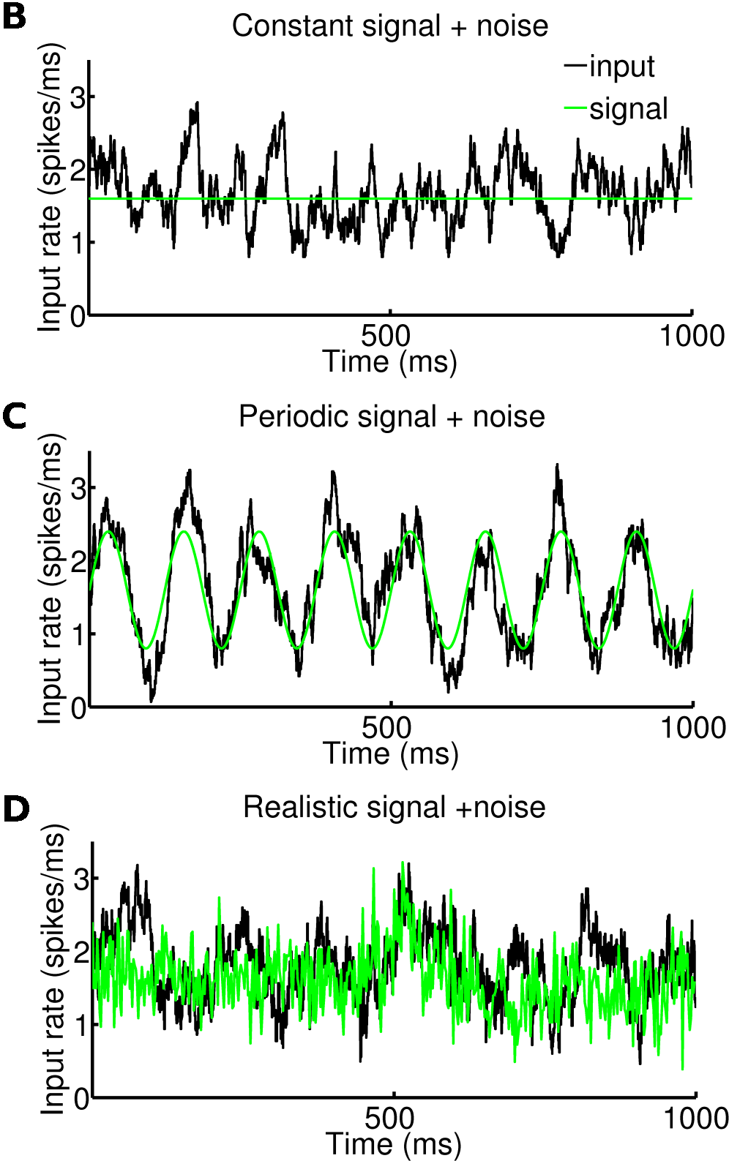

Integrate and fire models of local cortical excitatory-inhibitory networks
I
P
Unspecific
slow
cortical
activity
E
Thalamic input
Leaky integrate and fire neurons 4000 Excitatory Excitatory neurons 1000 Inhibitory Inhibitory neurons.
Sparse (p=0.2) random connections

Slide 3
Network response
to constant input
input:
costant signal + noise
Inhibitory neurons
spike rate
Excitatory neurons
spike rate
LFP=|I_{Excitatory}|+|I_{Inhibitory}|
on Excitatory neurons

Slide 4
Network response
to constant input
input:
costant signal + noise
Weak synchronization:
Oscillations are not visible in single neurons but only on local field potentials (or total firing rate, that is not accessible to experimenters)
Inhibitory neurons
spike rate
Excitatory neurons
spike rate
LFP=|I_{Excitatory}|+|I_{Inhibitory}|
on Excitatory neurons

Slide 5
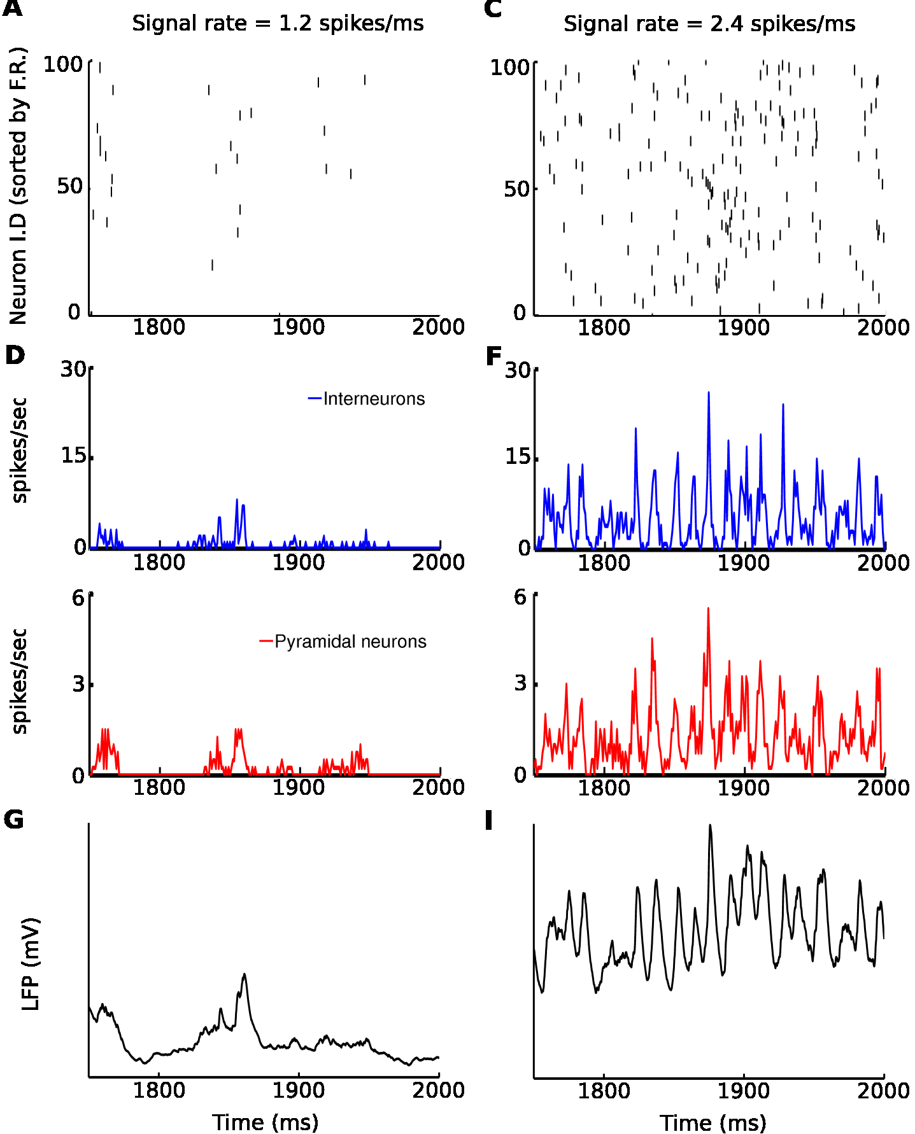
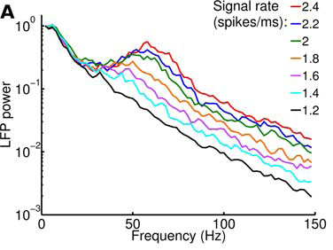
Network response to constant input
Inhibitory neurons
spike rate
Excitatory neurons
spike rate
The network internally generates only gamma-range (40-100 Hz) oscillations
The gamma power encodes the strength of the input
LFP=|I_{Excitatory}|+|I_{Inhibitory}|
on Excitatory neurons
Mazzoni, et al – PLoS Comp Biol (2008)
Mazzoni et al (2010) Neuroimage

Slide 6
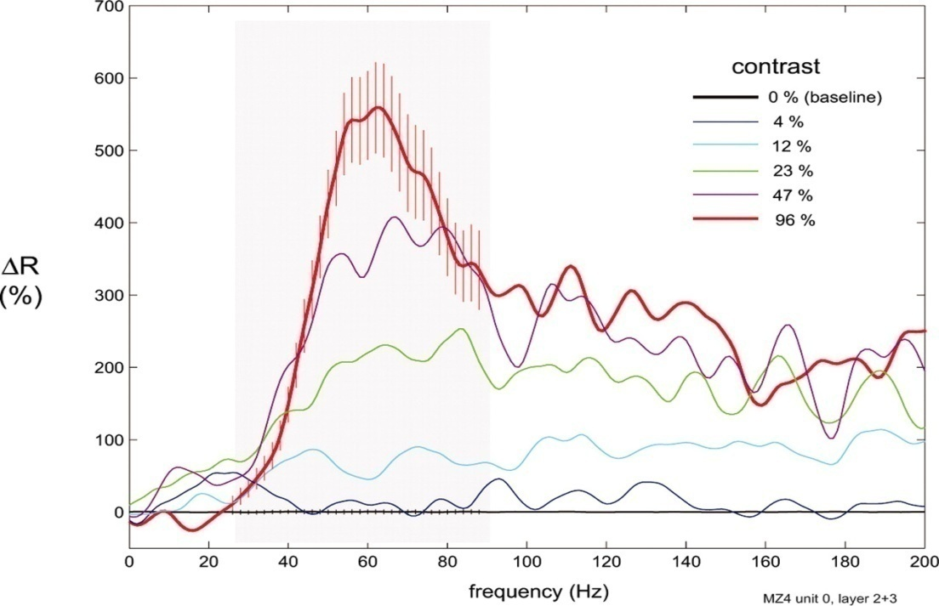
Network response to constant input
LFP from simulated cortical circuit
Modulation of the spectrum of LFP recorded in monkey V1 (Henrie and Shapley
J Neurophysiol 05)

Slide 7
Network response to constant input
Each constant signal is injected 20 times, every time with a different noise. In this way we can compute the information content of the spectrum. Since 8 different rates are injected the total entropy is 3 bits.
information
power
The peak of information is at ~70 Hz, slightly higher than the peak of the oscillations.
The information contained in the frequencies of the gamma band is highly redundant

Slide 8

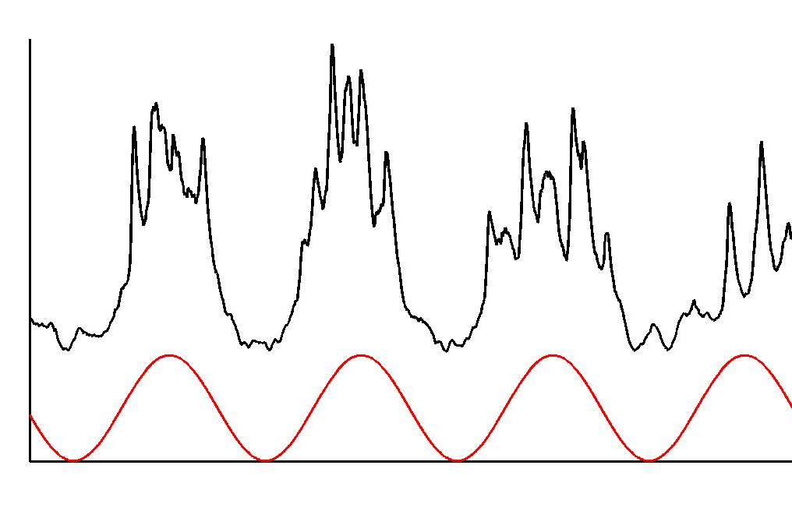
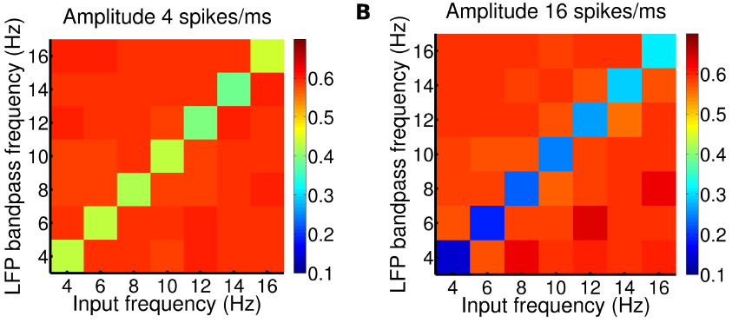
Delta oscillations origin
LFP
Signal
I
P
E
Intuitively: the slower network time constant is given by the dy-sinaptic P-I-P rhythm. Whatever is slower (<30/40 Hz) will not interfere with network rhythms and will entrain the network linearly.
Input

Slide 9
Network response to periodic input
Periodic signals with frequencies ranging from 4 to 16 Hz and 7 different amplitudes are used as input. Each signal is injected with 20 different noises. The total entropy is 5.6 bits.
Periodic signals entrain network LFP oscillations (the effect is stronger for lower frequencies).
Information about the lowest band of the signal spectrum is then contained in the same band of the network LFP.

Slide 10
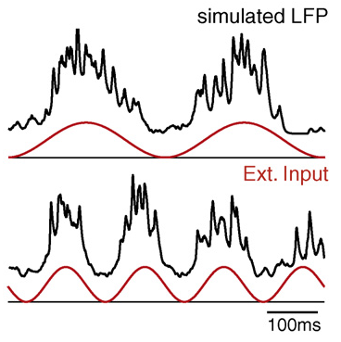
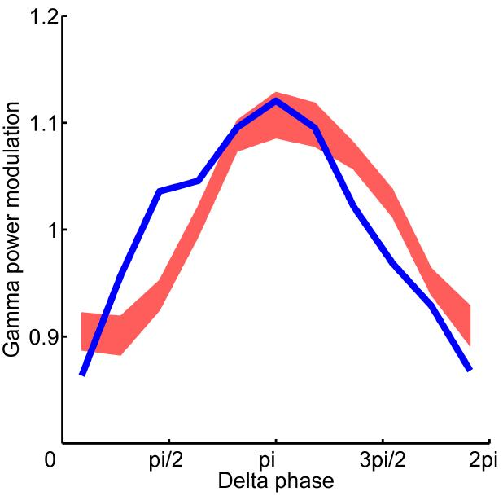
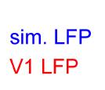
Cross-frequency coupling
The peak of slowly modulated inputs to the network will cause a peak in the low frequency component of the response LFP (because of entrainment) and a particularly high gamma power (because the latter encodes the strength of the input). This will lead to the cross-frequency coupling that is often observed experimentally.

Slide 11
Responses of the simulated network to input stimuli matching LGN spiking activity during naturalistic movies presentations
Stimuli matching LGN spiking activity during naturalistic movies presentations display a broad range of fluctuations.
According to the model, input peaks are associated to troughs in the LFP delta band and to a larger amplitude of the LFP gamma band.
The model correctly reproduces the information content of recorded LFP frequency bands during presentation of naturalistic movies.
Mazzoni et al. (2008)
PLoS Comp. Biol.

Slide 12
Responses of the simulated network to input stimuli matching LGN spiking activity during naturalistic movies presentations
There are two informative bands: frequencies below 10 Hz (”low frequencies”) and 30-100 Hz (gamma band). The two bands convey independent information. Furthermore low frequencies convey independent information from each other, while gamma frequencies are redundant.
Gamma band encodes signal rate
Delta band encodes slow signal components

Slide 13
Take home message(s)
During naturalistic stimulation, primary visual cortex multiplexes information by generating two complementary temporal information streams: slow (<10 Hz) fluctuations of the excitability of the local network, and fast (40-100 Hz) gamma oscillations.
These complementary information channels reflect different aspects of both neural dynamics and of stimulus representations.
Slow fluctuations reflect entrainment to the stimulus time course and thus provide “when” information about stimulus history
Fast oscillations (which are largely redundant to spiking activity) are internally generated by excitatory-inhibitory interactions and encode “what” information about the current stimulus strength

Slide 14
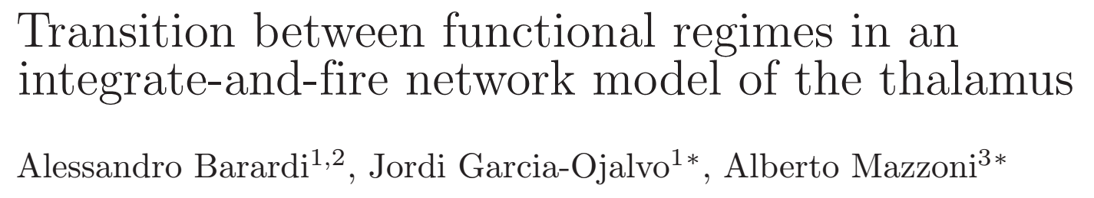
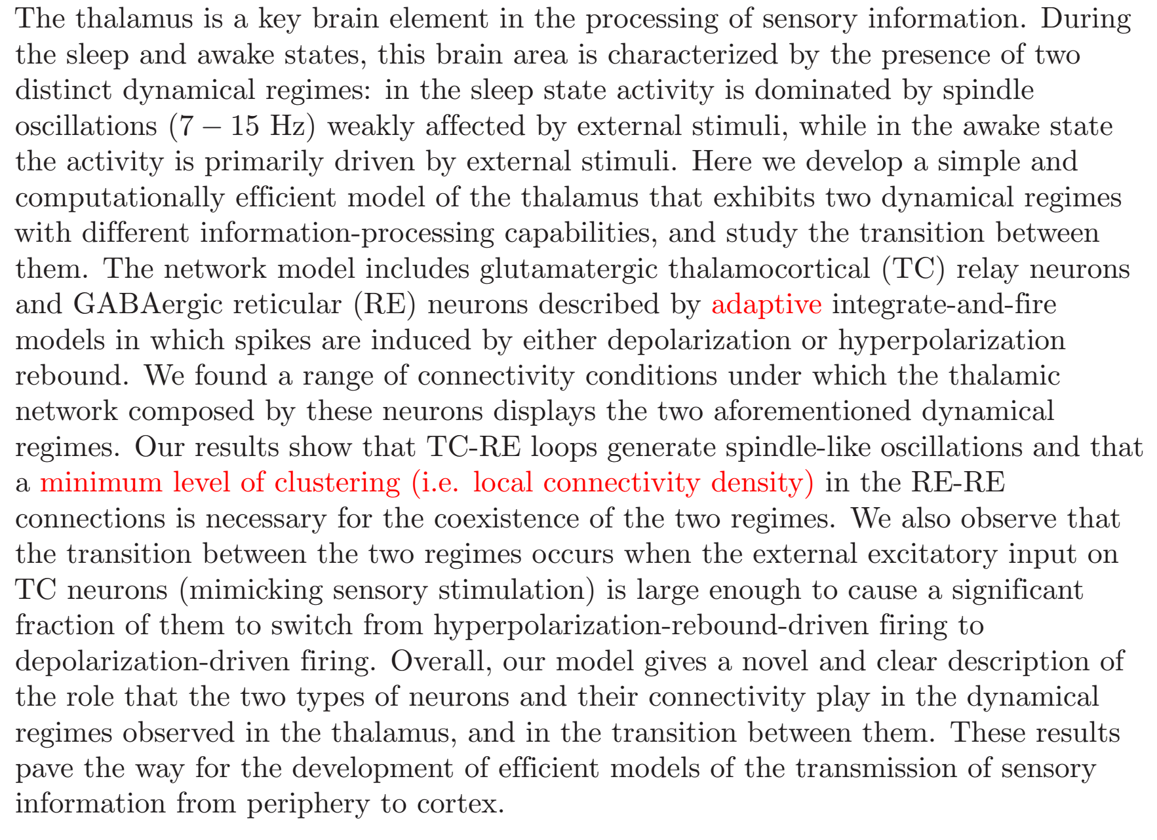
Thalamic oscillations

Slide 15
Thalamic oscillations
Modeling thalamus:
The thalamus is less studied and understood than the cortex and the periphery. But we do need to understand it for biomedical applications, like high level sensory feedback for whole arm amputated/ tetraplegic subjects, and deep brain stimulation for Tourette

Slide 16
Thalamic oscillations
Sleeping thalamus:
The thalamus acts as a gate for sensory inputs, and in particular during sleep oscillates at about 10 Hz to stop external stimuli below a given threshold.

Slide 17
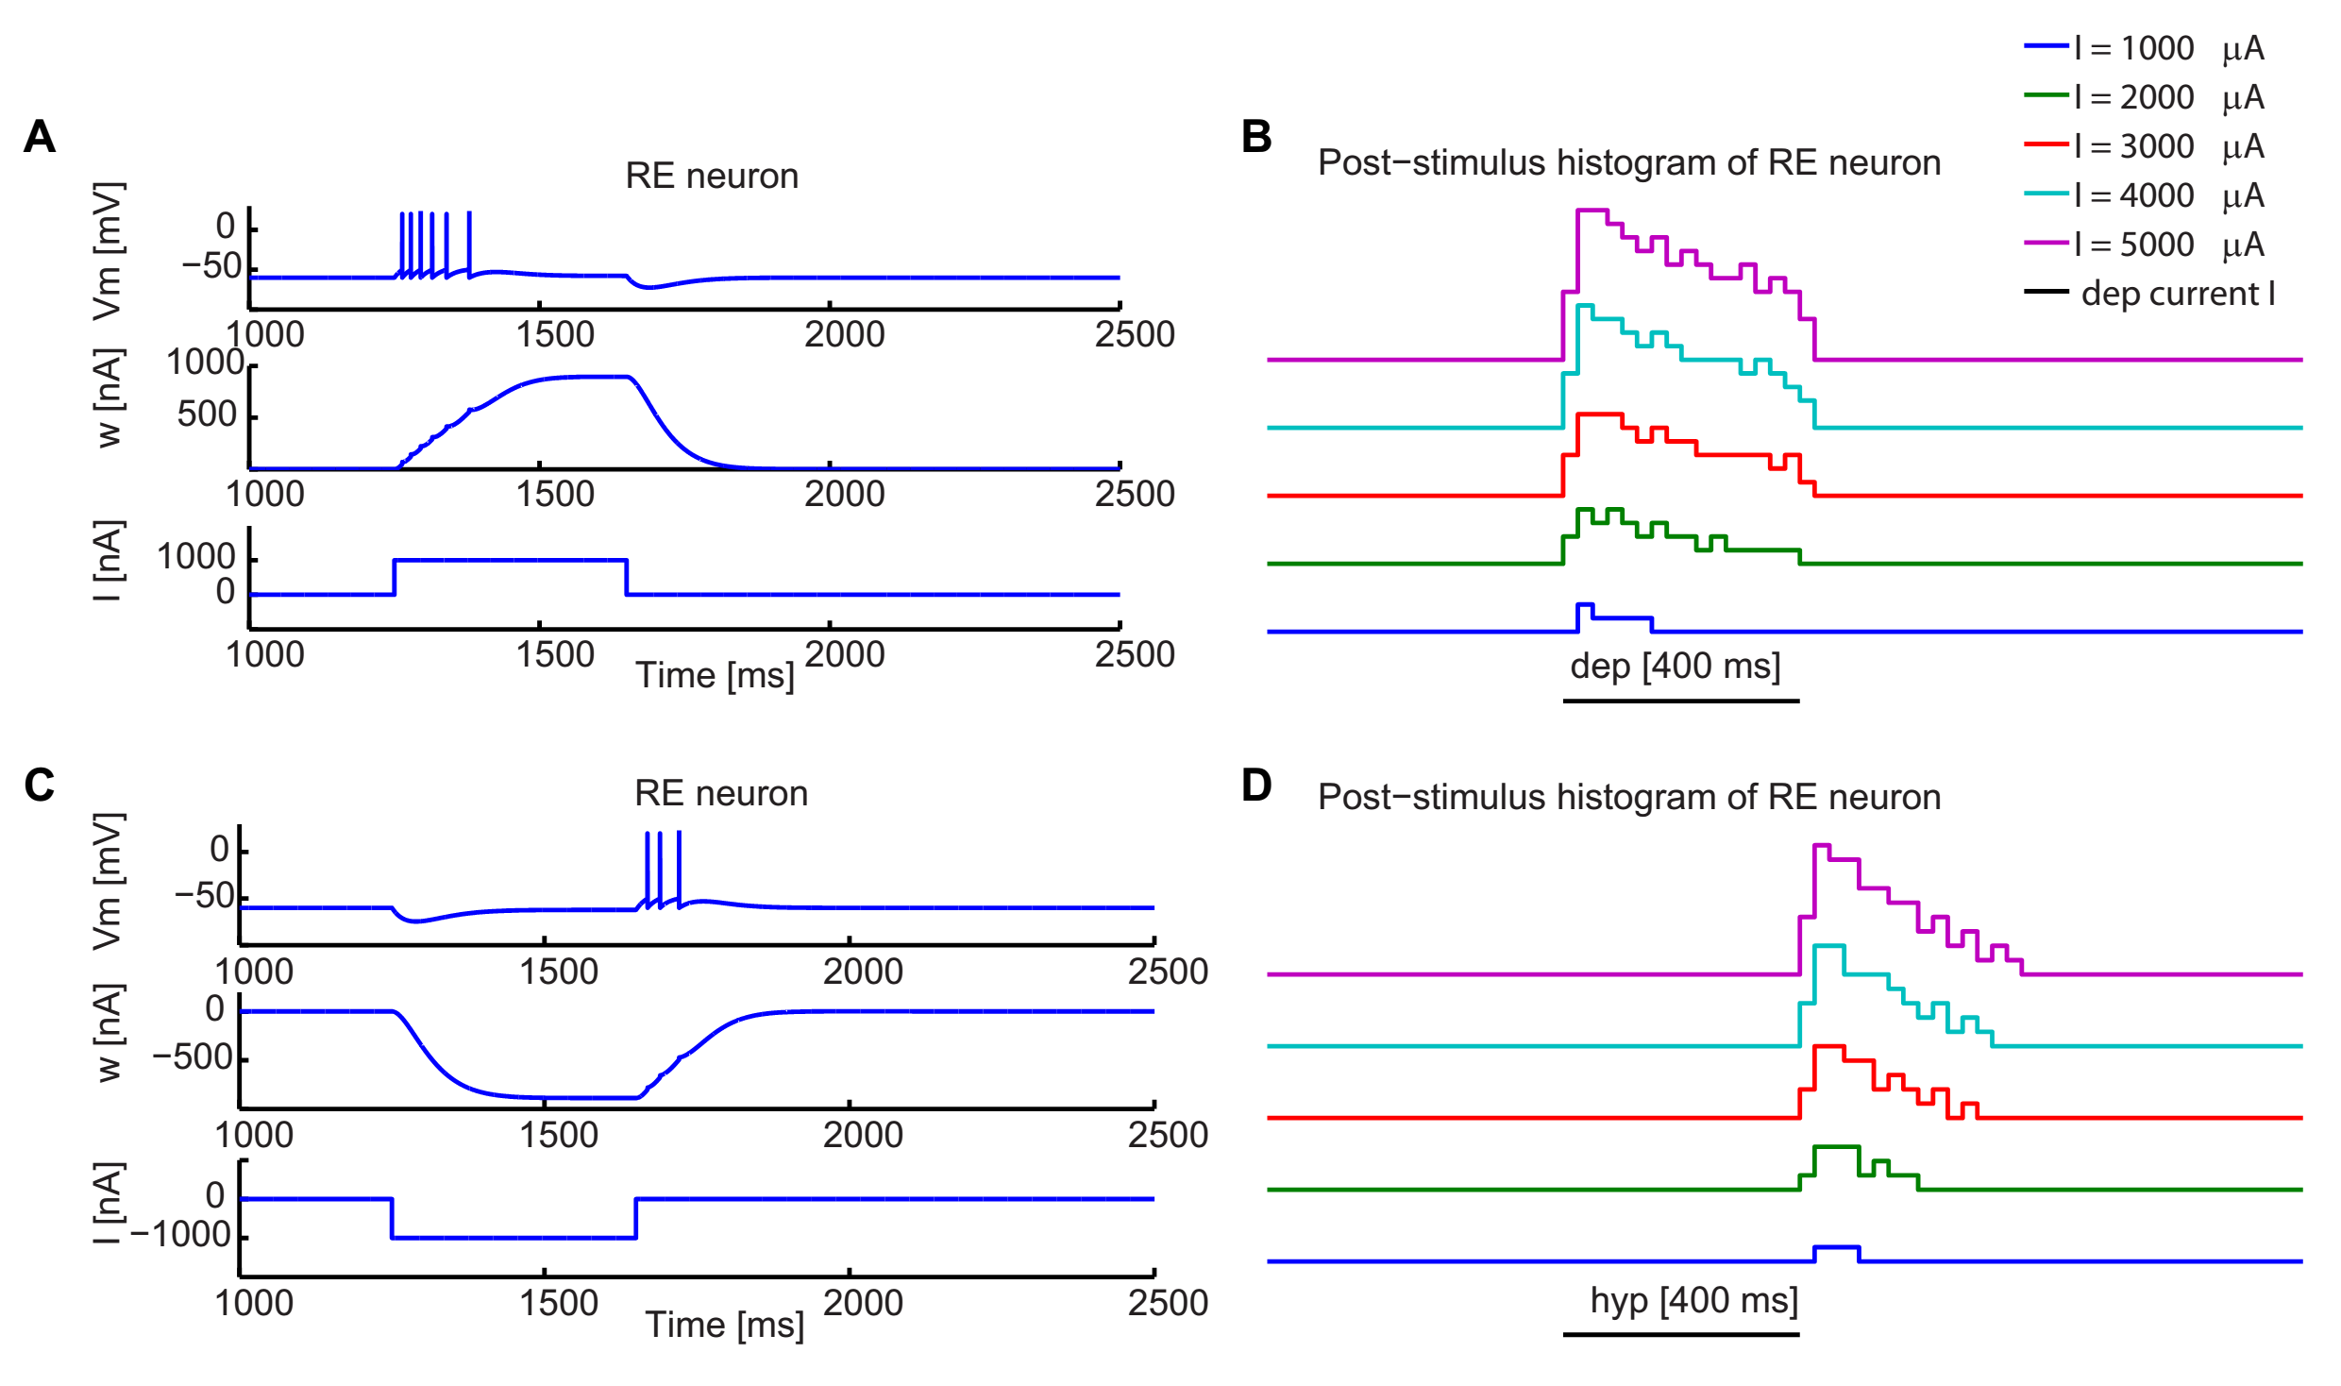
Single neuron description level

Slide 18
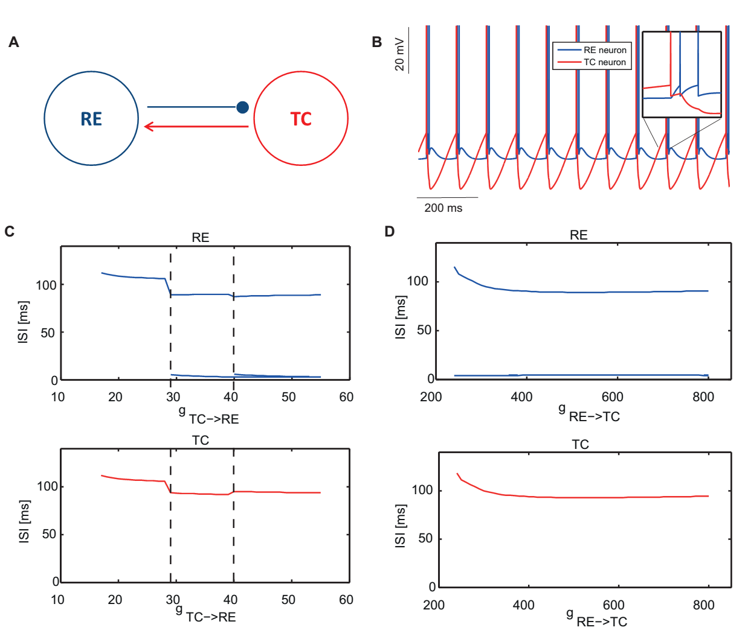
Basic oscillator

Slide 19
Basic oscillator
Self sustained oscillation in strongly adaptive network:
0 – External trigger activates TC neurons
1- TC are active and excite RE neurons – both sets are active
2- RE neurons inhibit TC neurons – only RE are active
3 – RE neurons do not receive excitatory inputs and shut down – both sets are silent
4- TC neurons do not receive inhibition anymore and start firing
5- -> back to step 1
Oscillations are self sustained after a first trigger

Slide 20
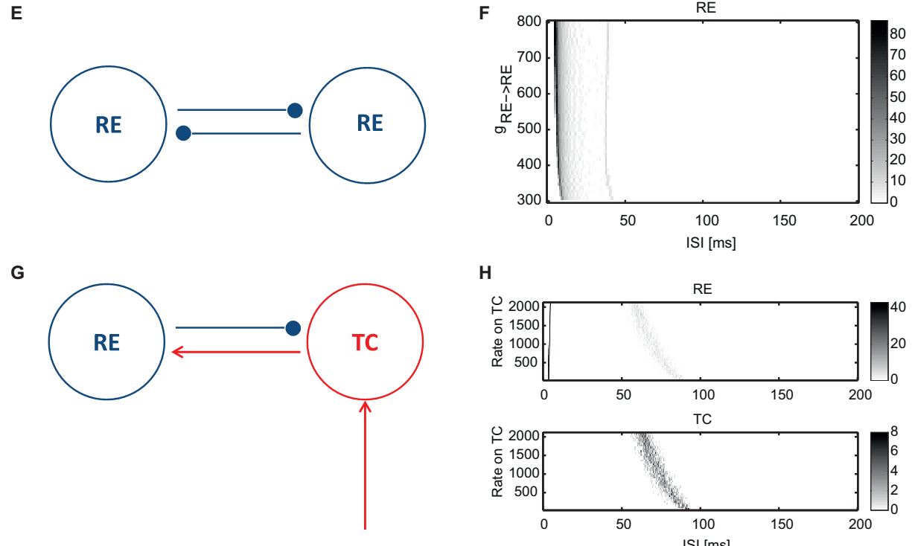
Other contributions to thalamus dynamics

Slide 21
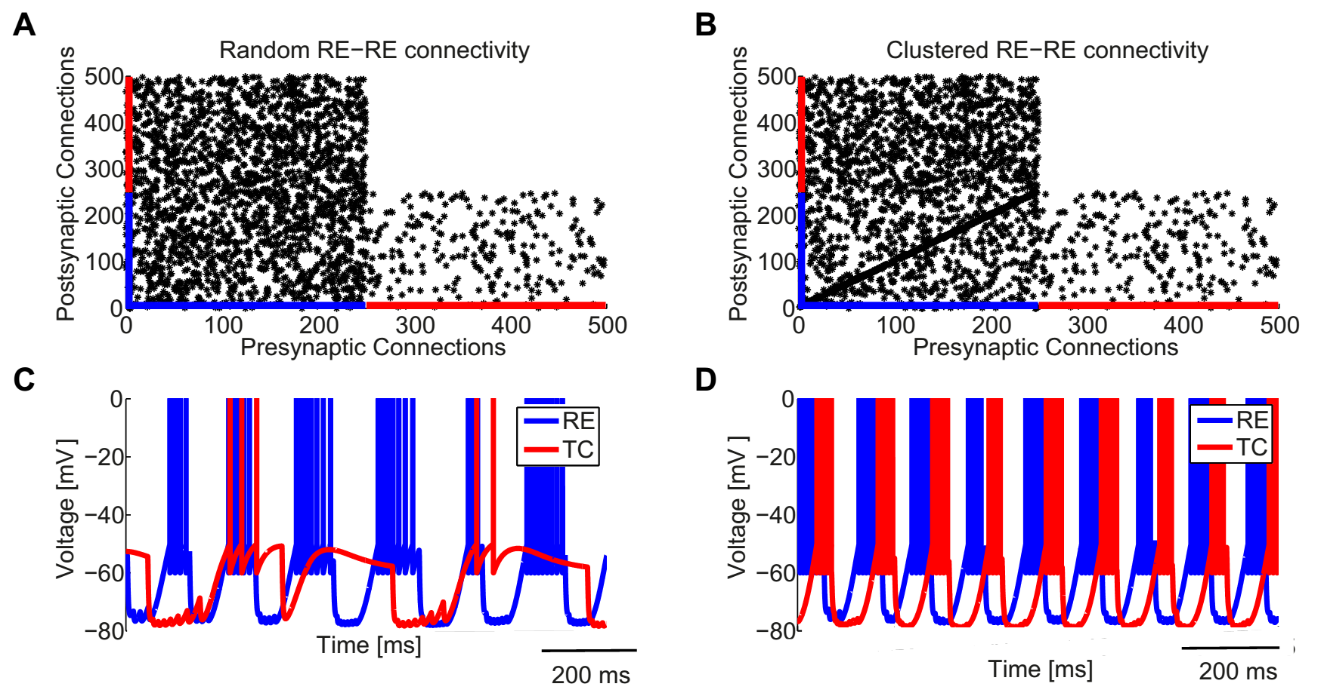
Oscillations and architecture

Slide 22
Oscillations and architecture
We know that in the thalamus there are not TC-TC connections, but what is the structure of the remaining connections?
First hypothesis :
Maybe random connectivity is just fine (we always start with the simplest hypothesis).
The hypothesis is rejected since we do not replicate the oscillations observed experimentally

Slide 23
Oscillations and architecture
Second hypothesis (after several months and failed attempts) :
We know that inhibitory connections tend to be local. We can take this into account by imaging that RE neurons are on a line (a ring) with a position 1:250 and connect them preferentially with closer ones.
This hypothesis is compatible with oscillations observed experimentally

Slide 24
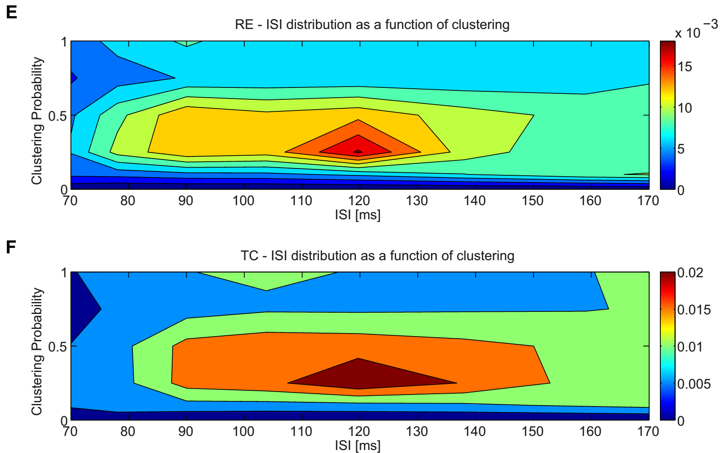
Oscillations and architecture

Slide 25
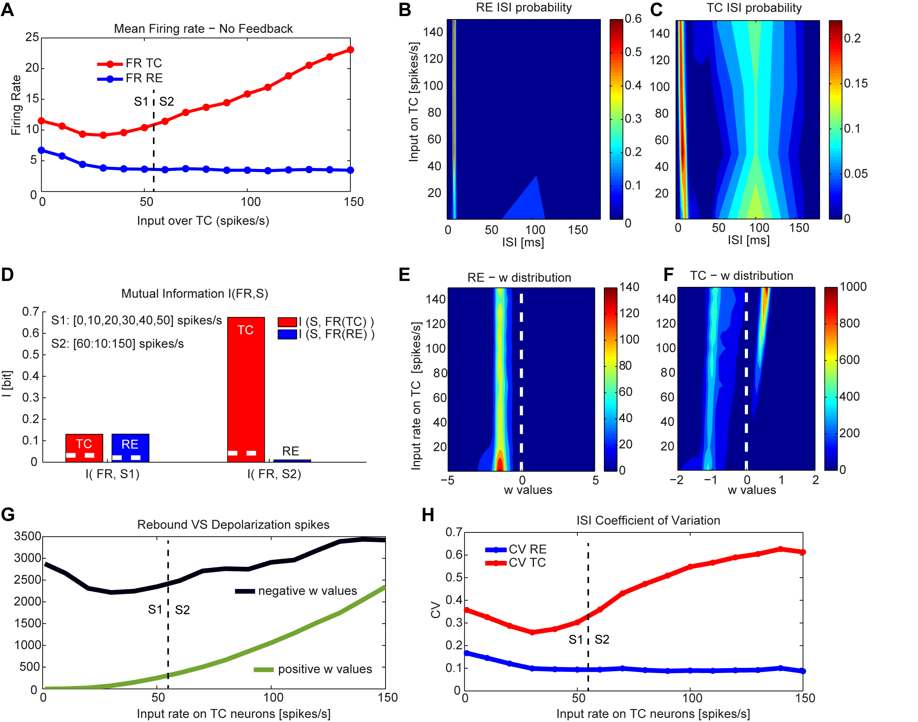
WAKING UP
Below 50: sleep state
Above 50: awake state

Slide 26
Increasing level of realism starting from LIF
Introducing ADAPTATION:
Izhikevich models (integrated)
Adaptive Exponential Integrate and Fire (plug-in)
Introducing ACTIVE CURRENTS:
HH models (the Nobel-prize squid)
EXC.
INH.
Introducing morphology:
NEURON
(and me)

Slide 27
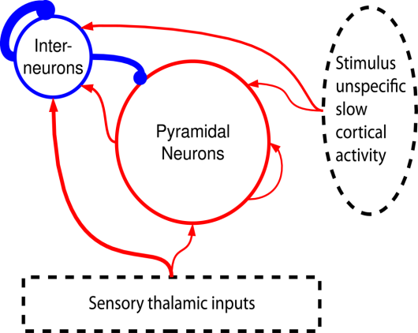
Rationale
Many network studies take starting point in generic E-I networks (of Brunel type). These models describe the network dynamics mainly through firing rates, while experimentally the activity of a network is often measured with extracellular recordings such as Local Field Potentials (LFP).
Brunel (J Comp Neurosci 2000)
Mazzoni et al. (PLoS Comp Biol 2008)
What are good models for LFP generation for such networks?
Idea: Compare LFP generated by point-neuron network model with LFP simulated using spatially embedded LFP models
Notes:
27
27
27

Slide 28

Rationale
Many network studies take starting point in generic E-I networks (of Brunel type). These models describe the network dynamics mainly through firing rates, while experimentally the activity of a network is often measured with extracellular recordings such as Local Field Potentials (LFP).
Brunel (J Comp Neurosci 2000)
Mazzoni et al. (PLoS Comp Biol 2008)
PCB,
Xmas 2015
Notes:
28
28
28

Slide 29

Our (classic) point-neuron model
4000 pyramidal neurons - 1000 interneurons
Sparse random connection (p=0.2)
Strong inhibition
Sensory thalamic inputs (stronger on interneurons)
Stimulus unspecific slowly varying OU inputs modeling ongoing cortical fluctuations
Poisson heterogeneity
NO spatial architecture at neuronal or network level.
Subthreshold:
Synaptic dynamics:
If
a spike is emitted
Vk drops to Vres
the neuron can not fire for a time τ ref
Mazzoni et al. (PLoS Comp Biol 2008)
Notes:
29
29

Slide 30
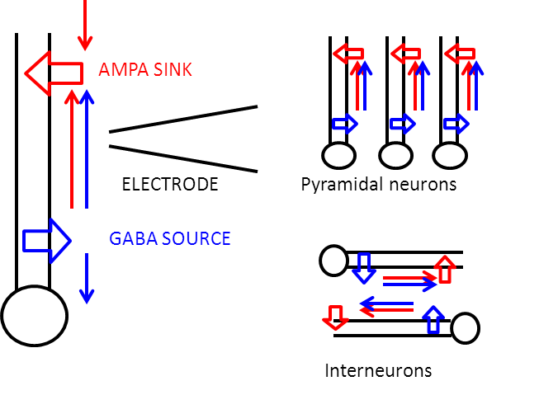
LFP and LIF
How do we map the results of
Integrate and Fire networks into experimental results about LFP?
For years the LFP has been approximated as the average membrane potential of all neurons in the network (spaceless)
Some interesting solutions
with a minimum amount
of spatial structure
have been proposed
Mazzoni et al. (2008) PCB
…but the problem still awaits for an optimal solution.
Notes:
30
30

Slide 31
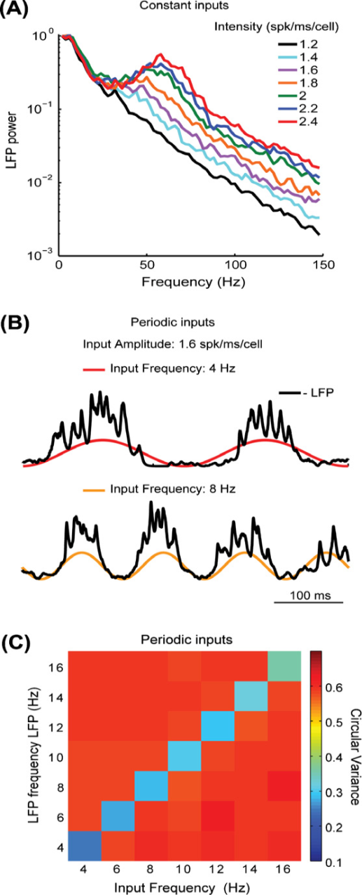
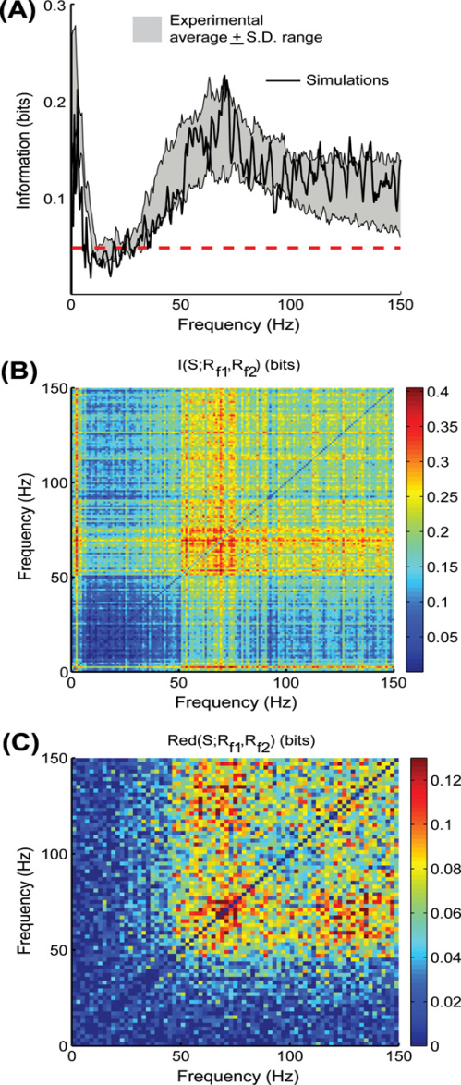
Network dynamics
This network was found to reproduce to some extent different V1 LFP dynamics
Gamma-band modulation by stimulus intensity
Entrainment to periodic stimuli
Cross frequency coupling
Multiplexing of information in LFP spectrum
that will be interesting
to study with a more realistic model
Mazzoni et al. (Plos Comp Biol 2008, Neuroimage 2010, J Physiol 2012)
Notes:
31
31

Slide 32
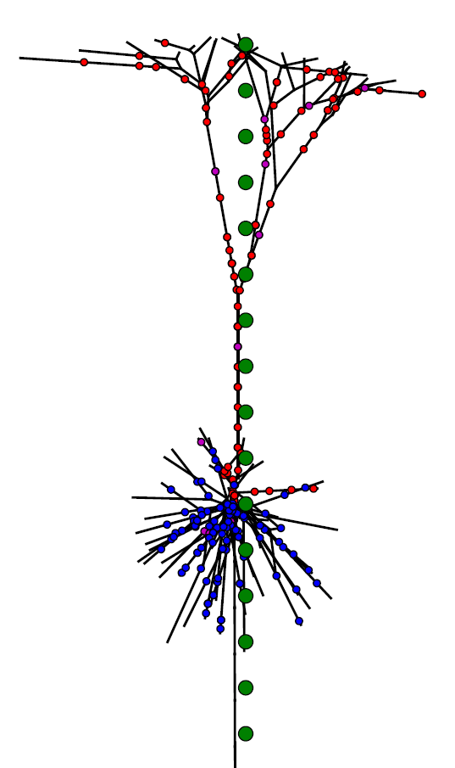

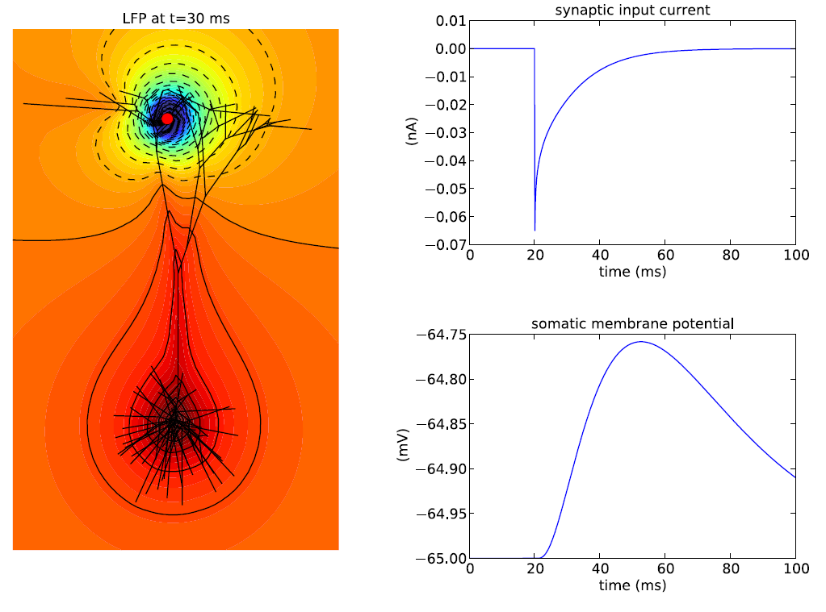

Morphological modeling
… very nice, but dynamics must be injected

Slide 33
Morphological modeling
Crucial note about figure on the left:
When you model the morphology (dendrites are black lines, red/blue buttons AMPA/GABA synpases), you can model also you neural interface (green circles are the contact sites of a laminar electrode), and hence test different kind of designs to maximize efficacy in reading/stimulating (see Romeni et al,2020)
… very nice, but dynamics must be injected

Slide 34

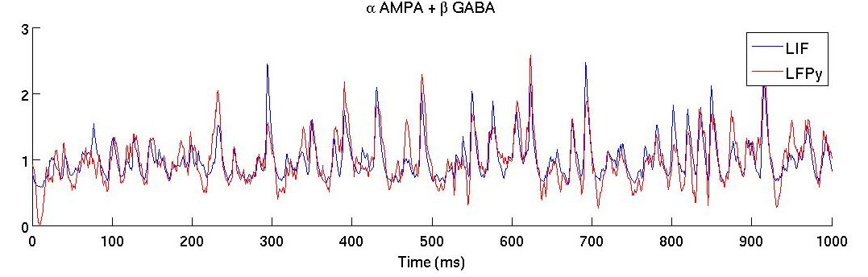
Our approach
+ network spatial architecture
+ neuron morphologies
+ synaptic distribution in space
spikes
LIF
LFP
LFPy
LFP
Notes:
34
34

Slide 35
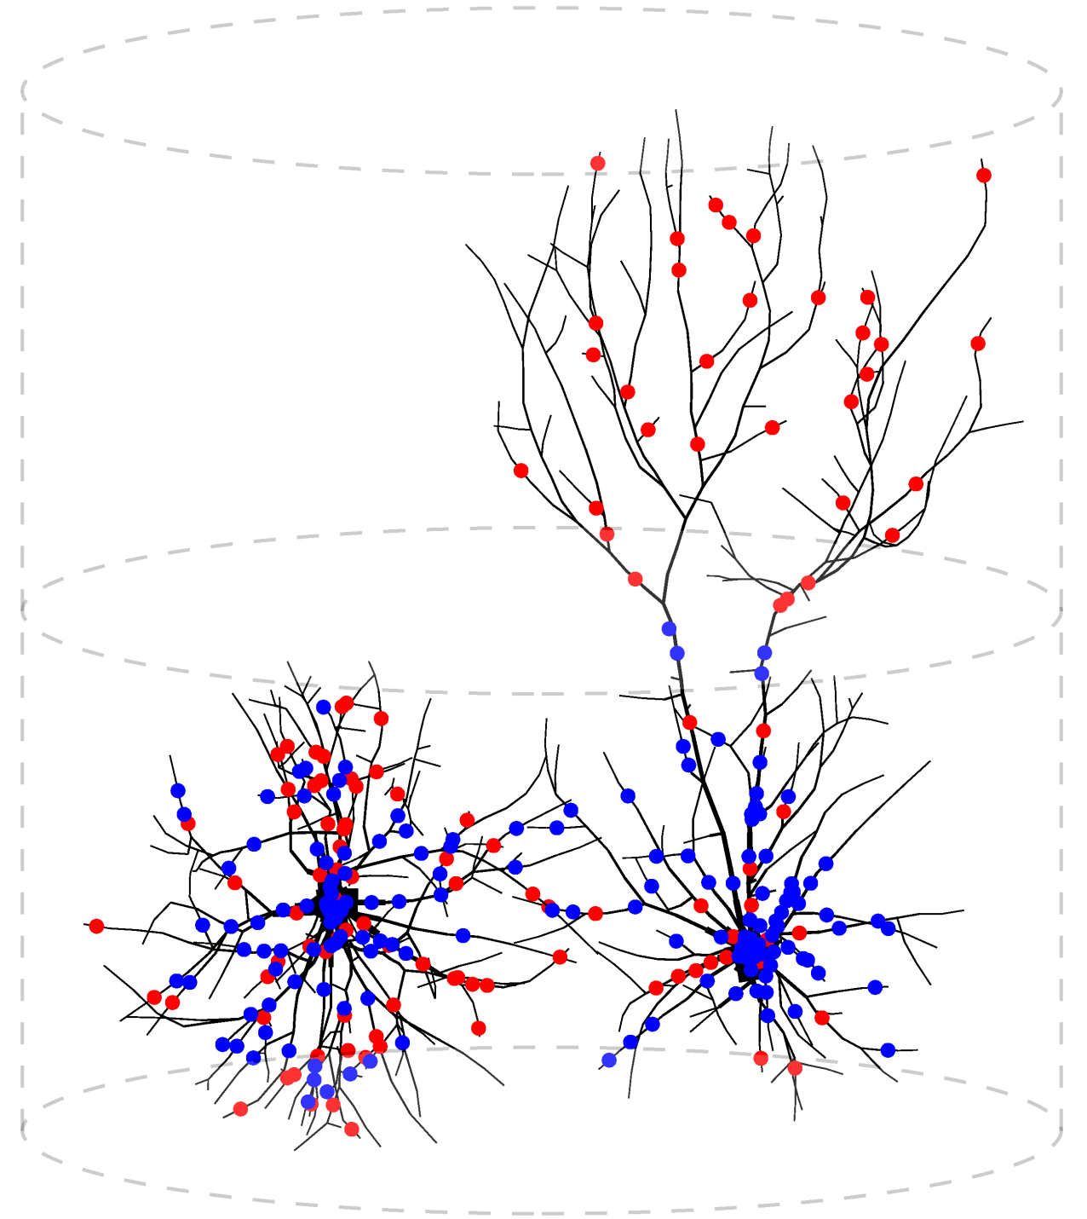
Building the network - morphology
250 um
Upper cylinder
We simulate only one layer (the contribution of different layers sum up linearly)
Layer 2/3 models
Realistic cortical density/ biophysical parameters/ synaptic dynamics.
Somas in the lower cylinder
Pyramidal neuron dendrites extend to the upper cylinder, interneurons dendrites don’t.
0
Lower cylinder
-250 um
Interneuron
Pyramidal
neuron

Slide 36
Building the network - morphology
Models are based on archives of single neuron’s pictures. As we want to model 5000 neurons but there are not 5000 pictures. So we took the few picture based models and we rotated, stretched, deformed them to take into account heterogeneity.
250 um
Upper cylinder
We simulate only one layer (the contribution of different layers sum up linearly)
Layer 2/3 models
Realistic cortical density/ biophysical parameters/ synaptic dynamics.
Somas in the lower cylinder
Pyramidal neuron dendrites extend to the upper cylinder, interneurons dendrites don’t.
0
Lower cylinder
-250 um
Interneuron
Pyramidal
neuron

Slide 37
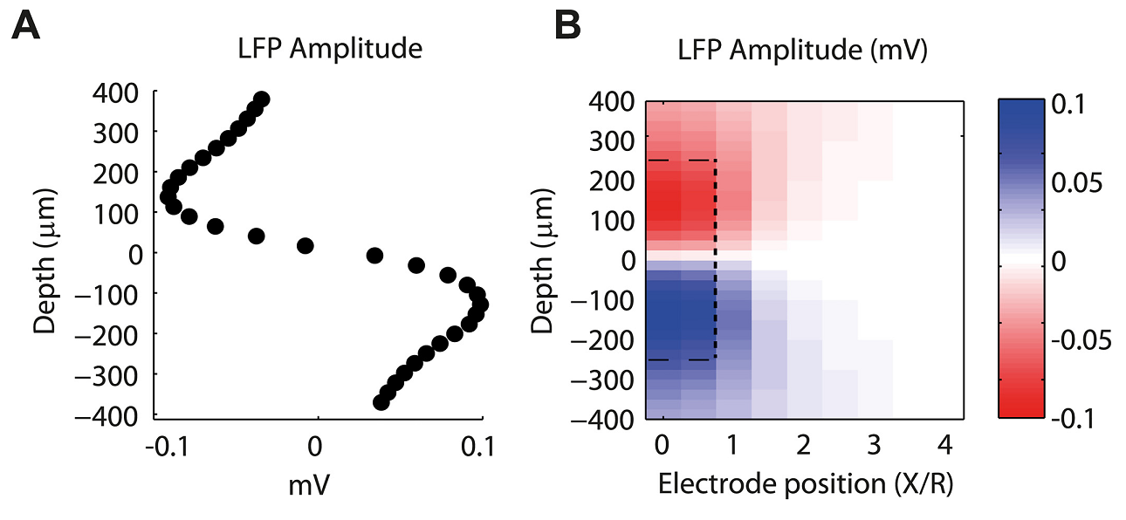
Network LFPy LFP
Input = 1.5 sp/ms constant + 0.5 sp/ms OU
Spatial structure with inversion point generated by one layer.
This analysis gives the scaling factor of the LFP amplitude that cannot be predicted by the LIF network

Slide 38
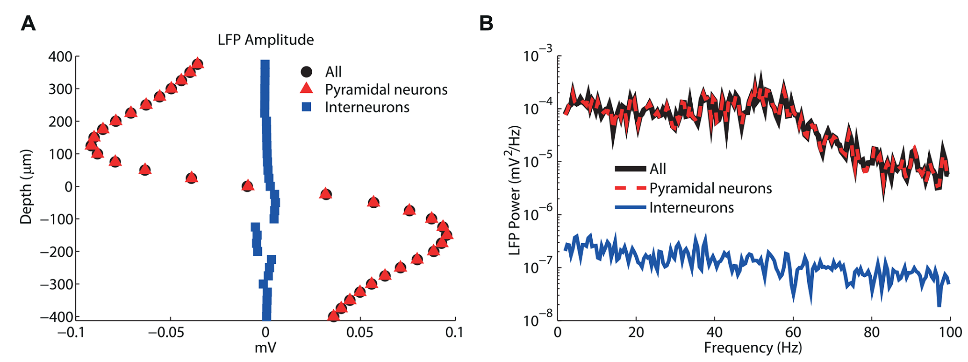
Network LFPy LFP
Input = 1.5 sp/ms constant + 0.5 sp/ms OU
Computing separately the LFP generated by the two populations we see that interneurons contribution is negligible.

Slide 39
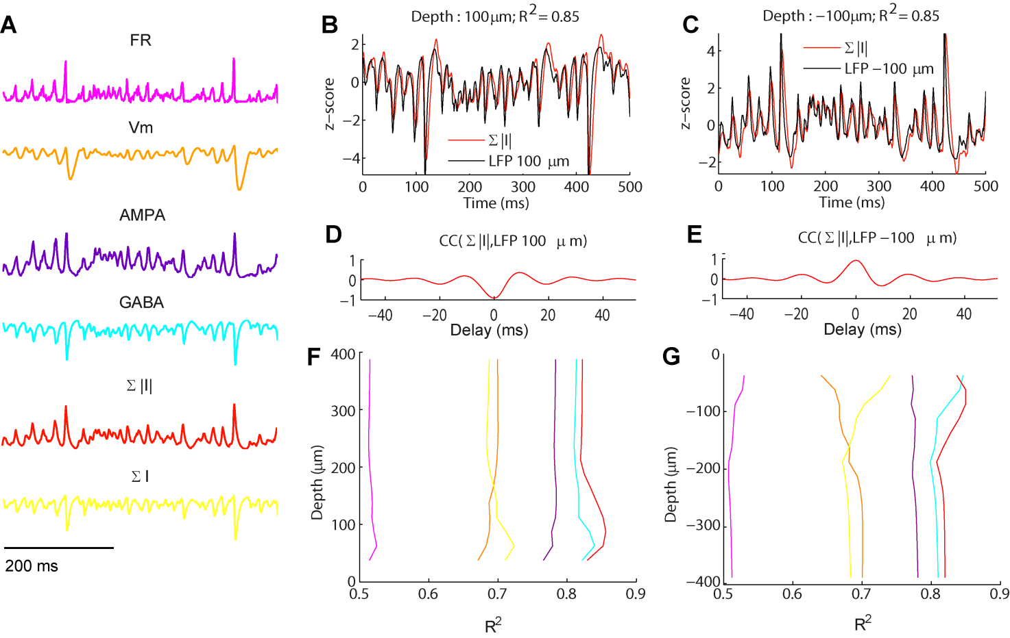
LIF dynamic variables

Slide 40
LIF dynamic variables
Take home message:
Firing rate is a terrible proxy for LFP,
Membrane potential is not a great proxy
Sum of absolute values is great,
but also taking into account only GABA synapses is quite ok.

Slide 41
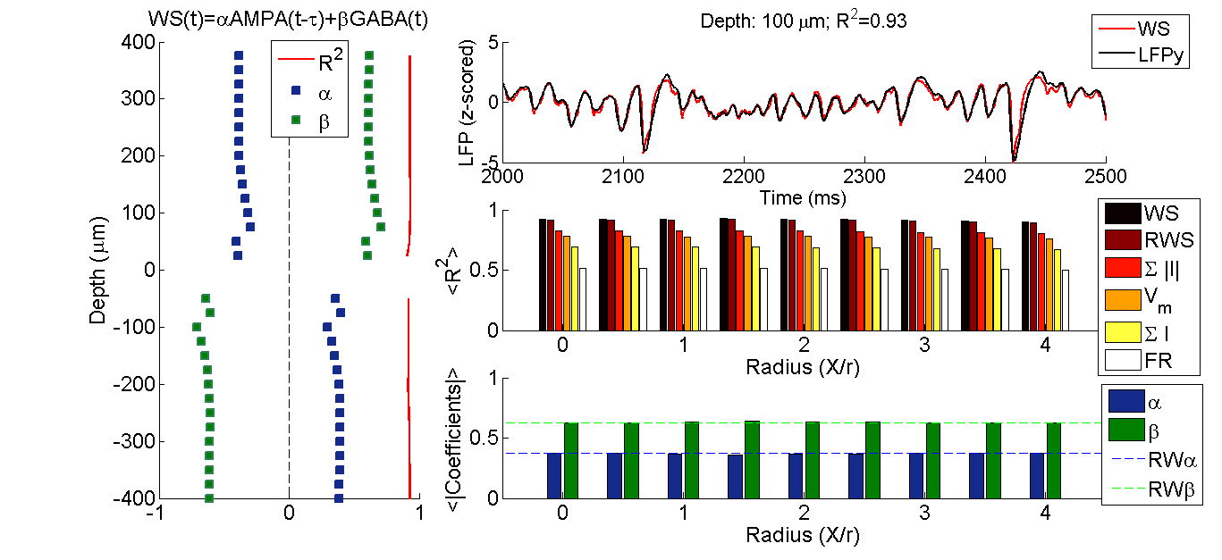
RWS proxy (or LFProxy)
LFP(t)=0.38AMPA_{pyr}(t-6ms)+0.62GABA_{pyr}(t)

Slide 42
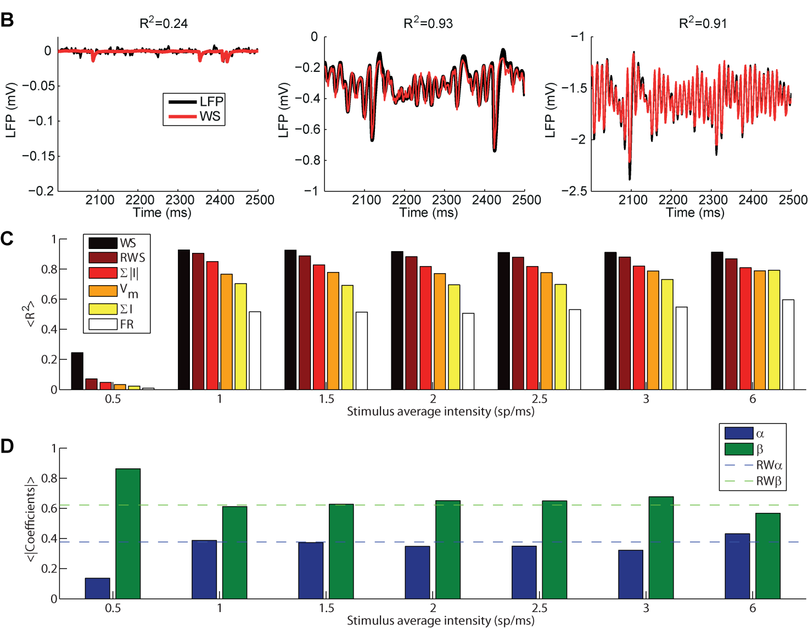
Stimulus modulation and dynamic regimes

Slide 43
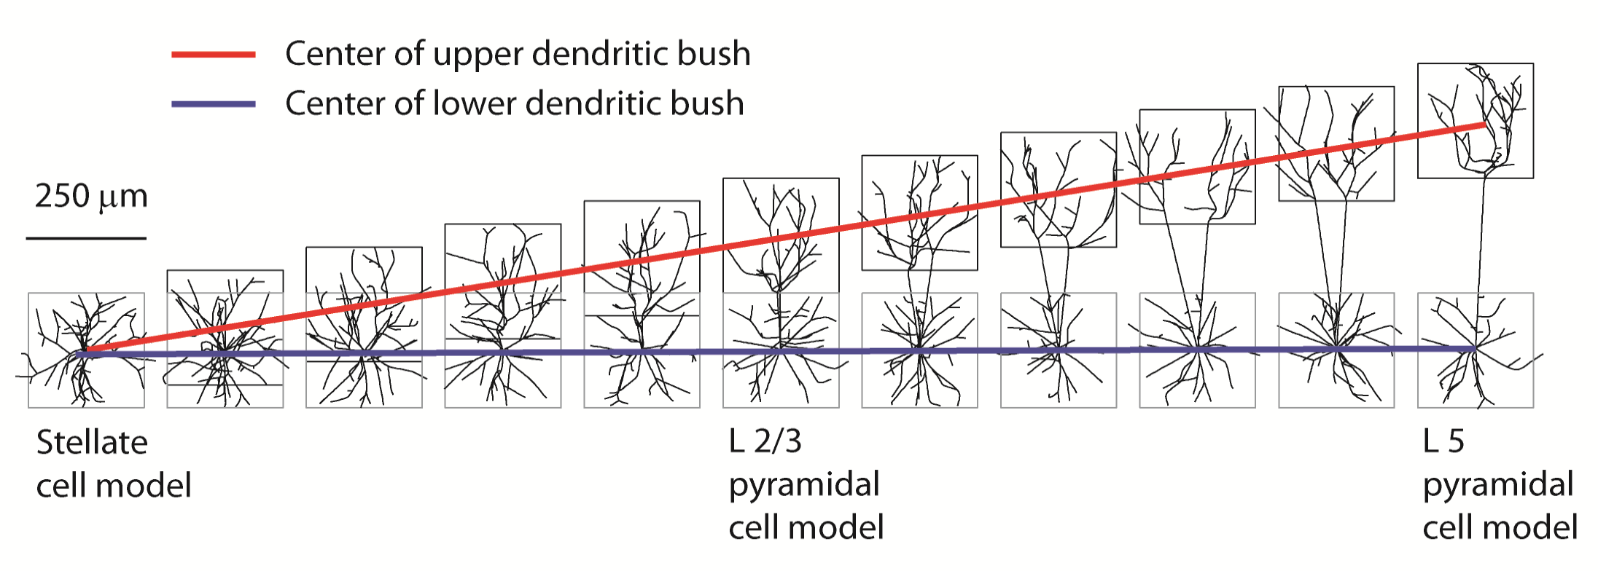
Morphology modulations
Is the negligible contribution of interneurons to LFP due to their morphology or to other static/dynamic factors?
If it’s all about morphology then how much asimmetry is needed to produce a relevant LFP?
How is our model coping with different morphologies?
All other factors are kept constant while the two bushes are progressively separated

Slide 44
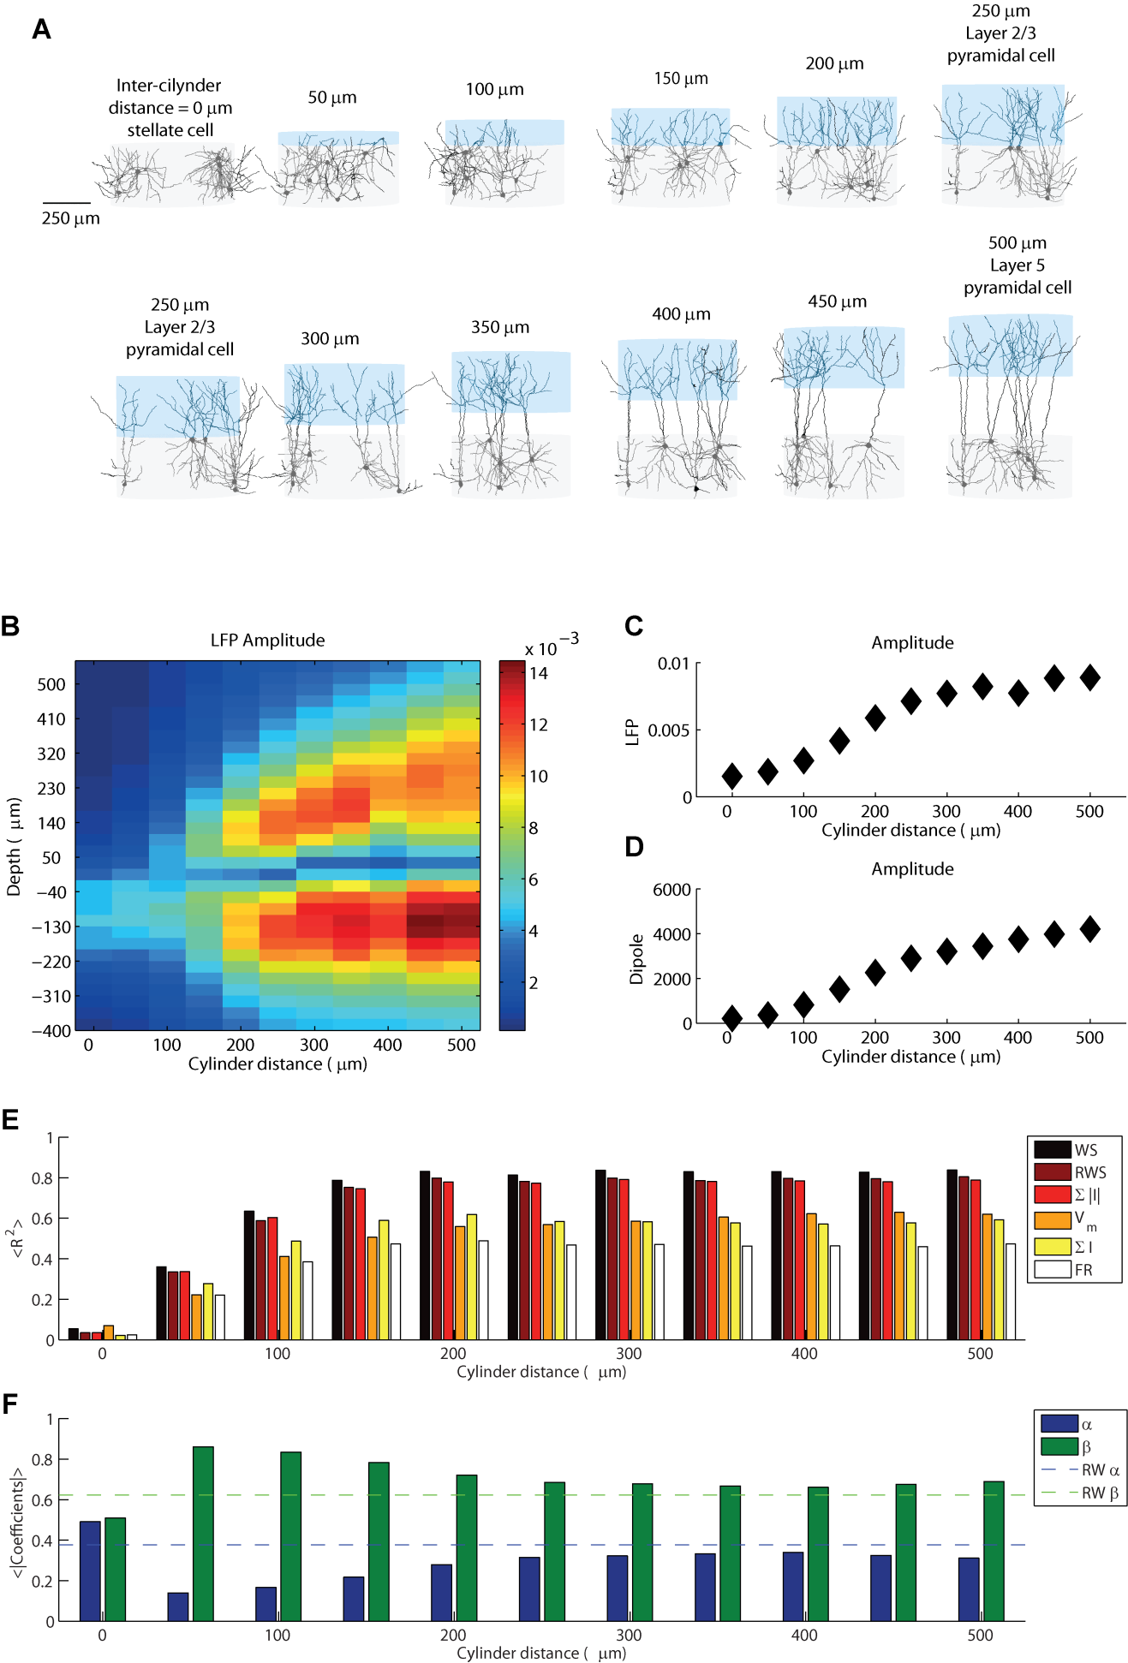
Morphology modulations

Slide 45
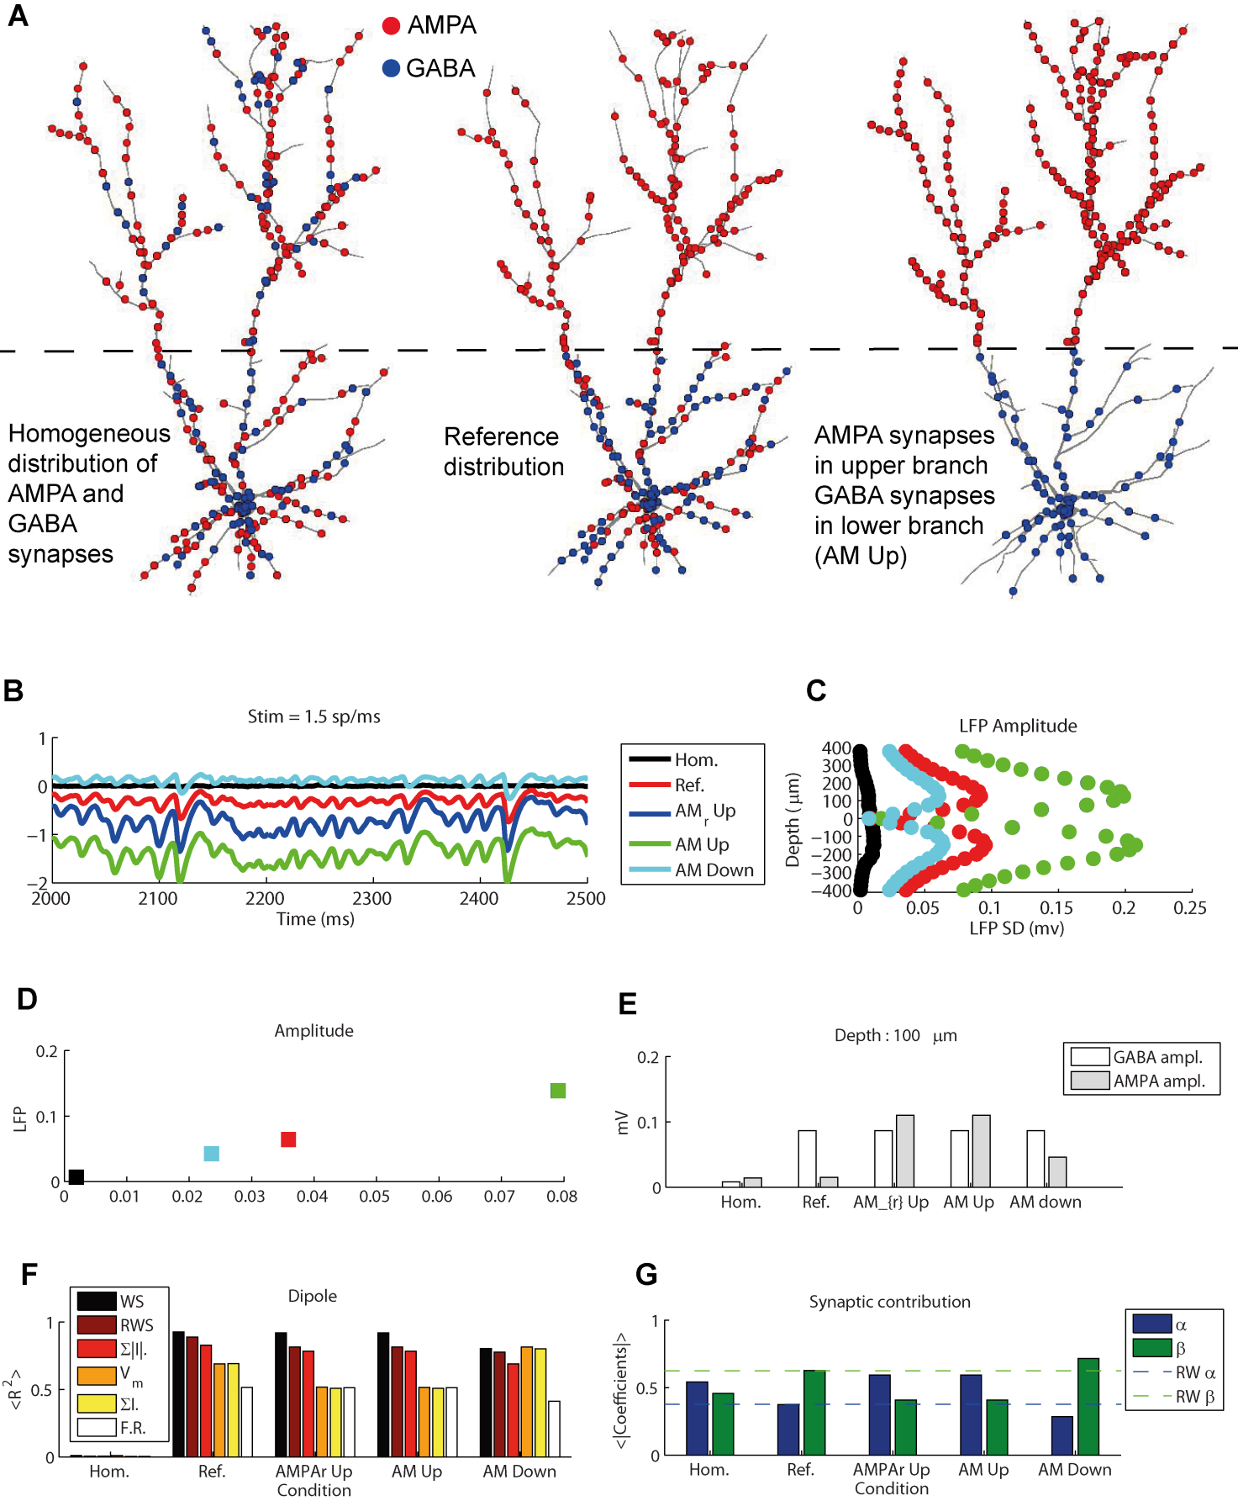
Synaptic distribution modulation
Homogeneous
GABA down.
GABA down - AMPA up

Slide 46
Synaptic distribution modulation

Slide 47
Conclusions of first and main part
The methodology of generating dynamics with LIF networks and inject it in morphological networks works quite well
Avoid using firing rate and membrane potential as LFP proxies
A weighted difference of GABA and AMPA currents is the best proxy under every condition investigated: the agreement between “ground truth” and LFP proxies is usually close to 90%
Our model does not perform optimally for “purely stellate” cells, but these do not give a significant contribution to the network LFP
The distribution of the different kind of synapses dramatically affects the LFP shape – however, our model can cope with this changes with an AMPA coefficient proportional to the AMPA synaptic density.
Our model performs well for current synapses and even better for conductance synapses
Complete set of layers
LFP → EEG → EcoG → MRI

Slide 48
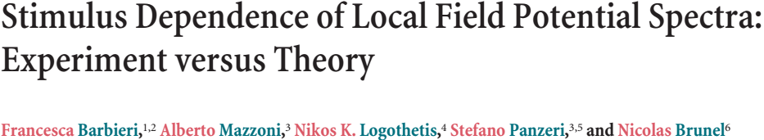
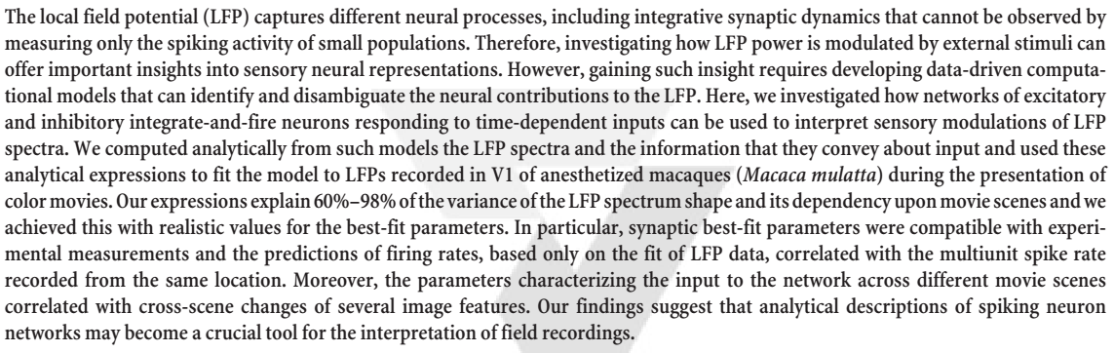

Slide 49

Theory
FIRING RATE SPECTRUM
LFP SPECTRUM
NOISE
INPUT FLUCTUATIONS
SYNAPTIC STRENGTH
SYNAPTIC FILTER (DESCRIBES HOW SYNAPTIC CURRENTS ARE PERTURBED BY PRE-SYNAPTIC FIRING RATE)
LFP SPECTRUM LOW FREQ ENTRAINMENT
LFP SPECTRUM HIGH FREQ RESONANCE

Slide 50
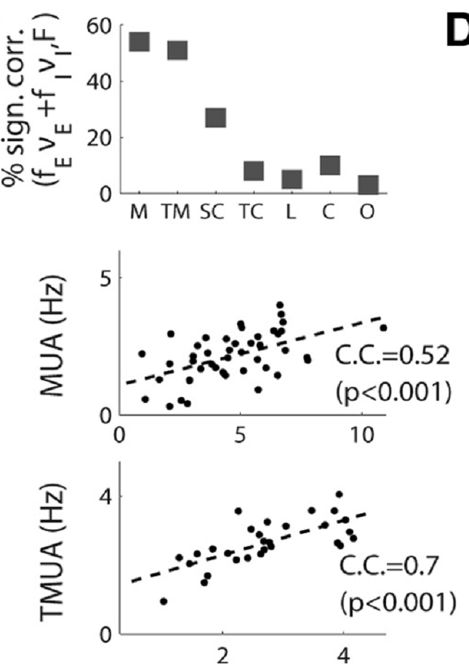

Experiment vs theory results I

Slide 51
Experiment vs theory results I
Thanks to equation 37 (and its timescale division):
We can reconstruct the microscopic firing rate from the mesoscopic LFP.
….and even the fluctuations of the visual feature in different scenes (see next slide).

Slide 52
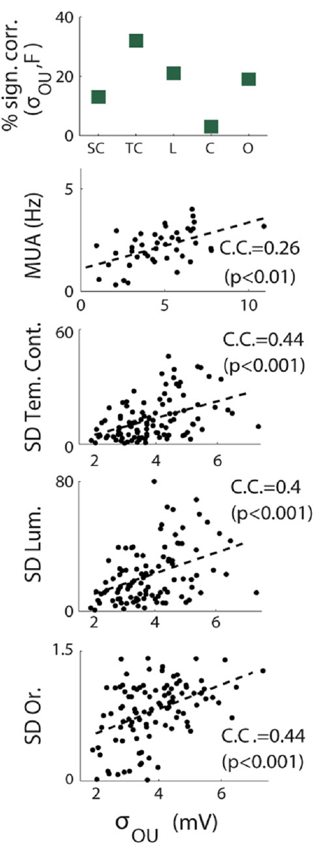
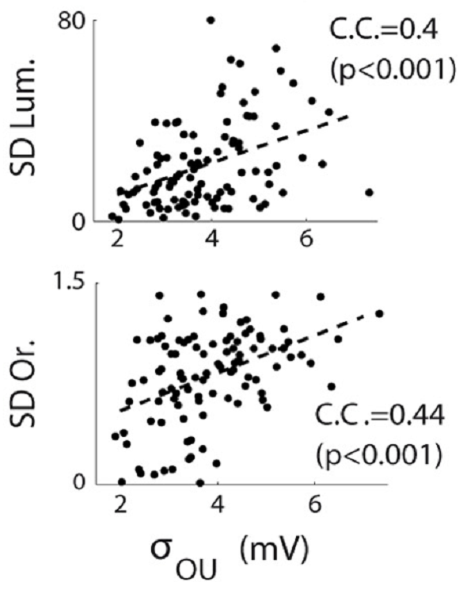
Experiment vs theory results II

